Slide 1
Final Presentation
on
Project
To design and implement Arduino based weather monitoring and
flood detection system
SUBJECT CODE – MTR-401
Session: AUG-DEC 2021
Presented by :-
Vishal (18BEM1057)
Shiva Thakur (18BEM1060)
Gauri Sankar Nayak (18BEM1053)
Bimelandu Bhaskar Pui (18BEM1052)
Project Supervisor :- Prof. Inderpreet Singh
Designation :- Assistant Professor
UIE-Department of Mechatronics Engineering
18-11-2021
UIE-Department of Mechatronics Engineering
1

Slide 2
Contents
Introduction
Literature Review
Review Analysis and Research Gap
Project Objectives
Experimental Setup/Procedure (H/W AND S/W → Block Diagram, Components, Design and Circuit or Prototype Snapshots)
Work plan or Division/ Timeline
Work done (Work by each Team Member)
References
UIE-Department of Mechatronics Engineering
UIE-Department of Mechatronics Engineering
UIE-Department of Mechatronics Engineering

Slide 3
Introduction
In this project we have aimed to enhance weather monitoring system at lowest cost possible. Our system is cable of capturing real time environmental data via different sensors we have installed. Our system can sense temperature, humidity, pressure, altitude, light intensity, rain, flood and air quality. Moreover data collected by these sensors can be accessed or observed on Think speak webpage across the globe.
UIE-Department of Mechatronics Engineering
UIE-Department of Mechatronics Engineering
Department of Mechatronics Engineering

Slide 4
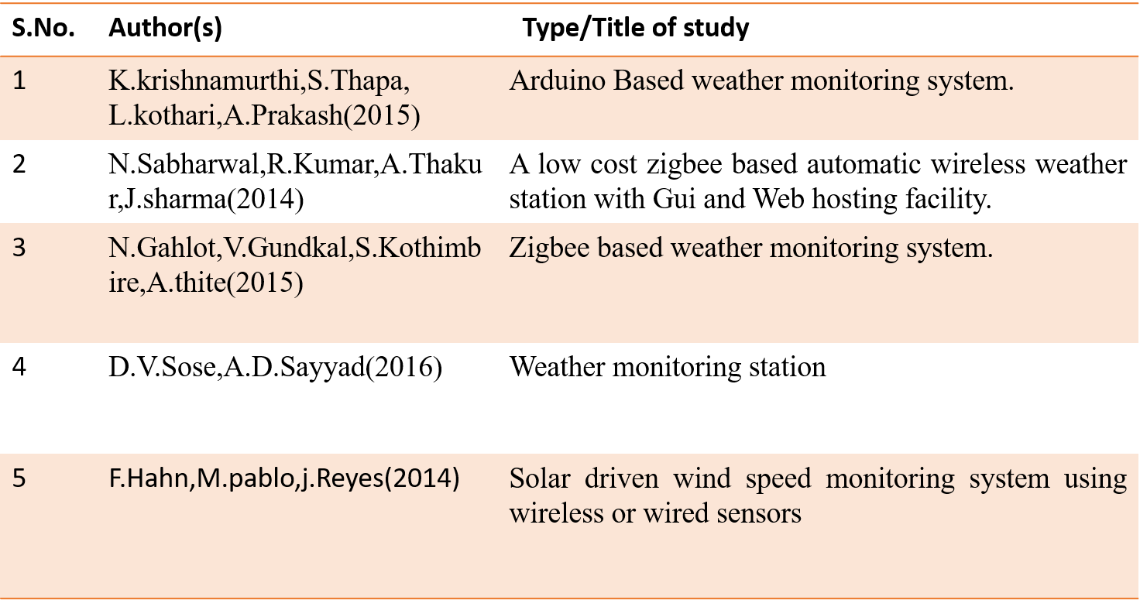
Literature review
UIE-Department of Mechatronics Engineering
UIE-Department of Mechatronics Engineering

Slide 5
Review Analysis
The paper demonstrates a simple and low cost system design to measure climate components in perfect competence .
In the above mentioned papers they haven’t used such type of components that would help us to know about the fluctuation that occurs in weather .
.
N.Sabharwal paper dealt with low cost zig-bee based automatic wireless weather station where the technology is developed as an open global standard to address the unique needs of low cost, low power wireless iot networks. They haven’t use any type of Arduino and sensors that can detect and observe the fluctuation that happens in weather .
UIE-Department of Mechatronics Engineering

Slide 6
Research Gap
In majority of the mentioned papers and the other data sources we have gone through we founded that
Majority of them have used NODE MCU which has in built wi-fi facility to connect with IOT but that is expensive and only has a single analog pin which is main issue but in our project we have used a combination of Arduino Uno development board with ESP-8266 wi-fi module which makes our project the cheapest and issue of analog pin is also resolved as Arduino uno has A0-A6 analog pins.
None of the weather monitoring system was able to detect flood in advance.
UIE-Department of Mechatronics Engineering

Slide 7
Project Objectives
The main objective of our project is to collect environmental data via variety of sensors and to display it graphically on Thinkspeak webpage .
To save life of Human/animals and to Minimize destruction/damage that a sudden flood can cause and lowering the risk by alerting in advance about flood or abrupt incr. in water level .
To gather environmental data for research purpose or to make weather prediction .
To acquire data from sensors and transmit weather data remotely around globe
UIE-Department of Mechatronics Engineering

Slide 8
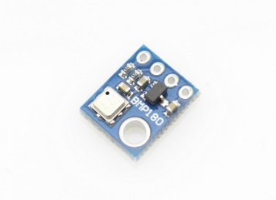


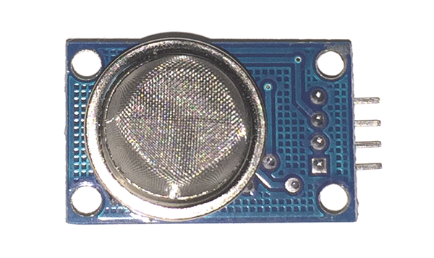
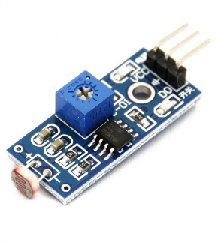
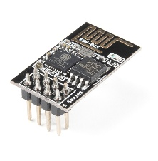
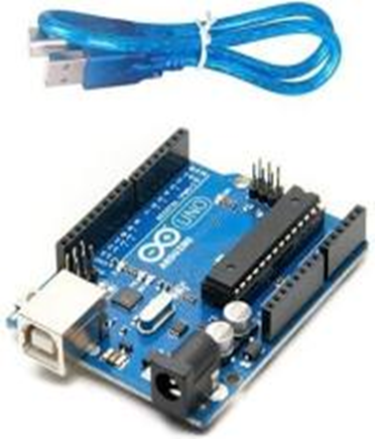

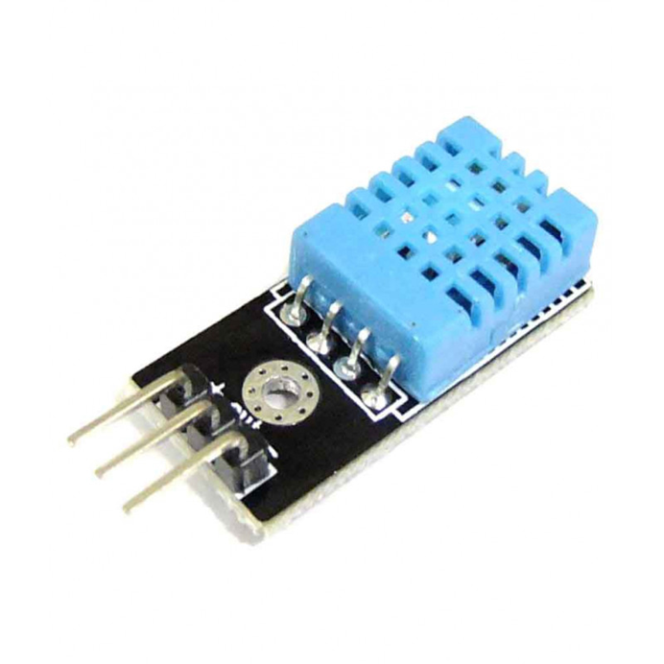
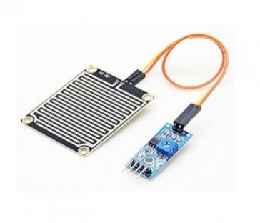
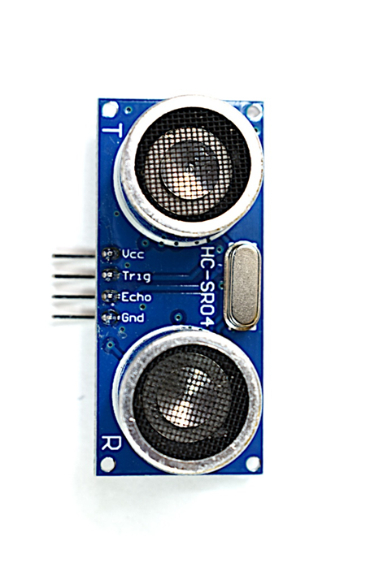


Experimental Setup
UIE-Department of Mechatronics Engineering

Slide 9
Block diagram
Air quality (Mq-135)
PC
Wi-Fi Router/Hotspot
Humid. & Temp. DTH-11
Arduino Uno
ESP8266-01 wi-fi module
Pressure & altitude
BMP-180
Rain Sensor
Flood detection
HC-SR04
Internet/Think speak webpage
Light Intensity
LM-393
Buzzer/ Led
UIE-Department of Mechatronics Engineering

Slide 10
Components
ARDUINO UNO (Development board)
ESP8266-01(wi-fi module)
DTH-11 (Temperature & Humidity sensor)
BMP-180 (Pressure, Temperature and Altitude sensor)
MQ 135 (Air quality monitoring sensor)
LM-393 module (Light intensity sensor)
HC-SR04 (Ultrasonic sensor)
Bread board
Jumper wires
Empty PCB flex
Soldering iron, wire and flux
Power regulators, capacitors, resistors, led, piezo electric buzzer etc.
09-12-2021
UIE-Department of Mechatronics Engineering

Slide 11

Aurduino UNO and Specifications
Microcontroller | ATmega328P
Operating Voltage | 5V
Input Voltage (recommended) | 7-12V
Input Voltage (limit) | 6-20V
Digital I/O Pins | 14 (of which 6 provide PWM output)
PWM Digital I/O Pins | 6
Analog Input Pins | 6
DC Current per I/O Pin | 20 mA
DC Current for 3.3V Pin | 50 mA
Flash Memory | 32 KB (ATmega328P) of which 0.5 KB used by bootloader
SRAM | 2 KB (ATmega328P)
EEPROM | 1 KB (ATmega328P)
Clock Speed | 16 MHz
LED_BUILTIN | 13
UIE-Department of Mechatronics Engineering
11

Slide 12
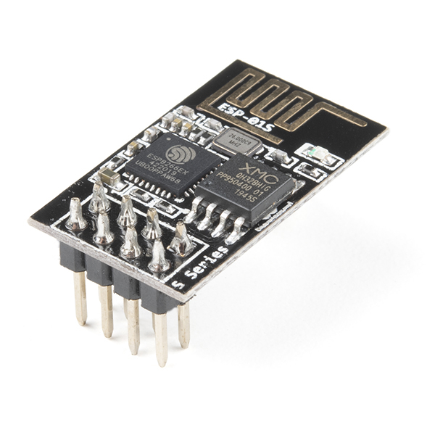
ESP8266-01 (wi-fi module)
The ESP8266-01 Wi-Fi Module is a networking device This small module of capable of connecting the development boards to internet it work as personal wi-fi station/hotspot.
However it’s main use is for function in any system is to be able to connecting to any nearby Wi-Fi network for uploading or downloading data hence enabling IOT.
UIE-Department of Mechatronics Engineering

Slide 13

DTH-11 Sensor module
The DHT11 is a basic, ultra low-cost digital temperature and humidity sensor.
operating Voltage: 3.5V to 5.5V.
Operating current: 0.3mA (measuring) 60uA (standby)
Output: Serial data. Temperature Range: 0°C to 50°C.
UIE-Department of Mechatronics Engineering

Slide 14

Rain Sensor
A rain sensor is one kind of switching device which is used to detect the rainfall. It works like a switch and the working principle of this sensor is, whenever there is rain, the switch will be normally closed.
The area of this sensor includes 5cm x 4cm and can be built with a nickel plate on the side
The sensitivity can be adjusted by a potentiometer
The required voltage is 5V
The size of the small PCB is 3.2cm x 1.4cm
UIE-Department of Mechatronics Engineering

Slide 15
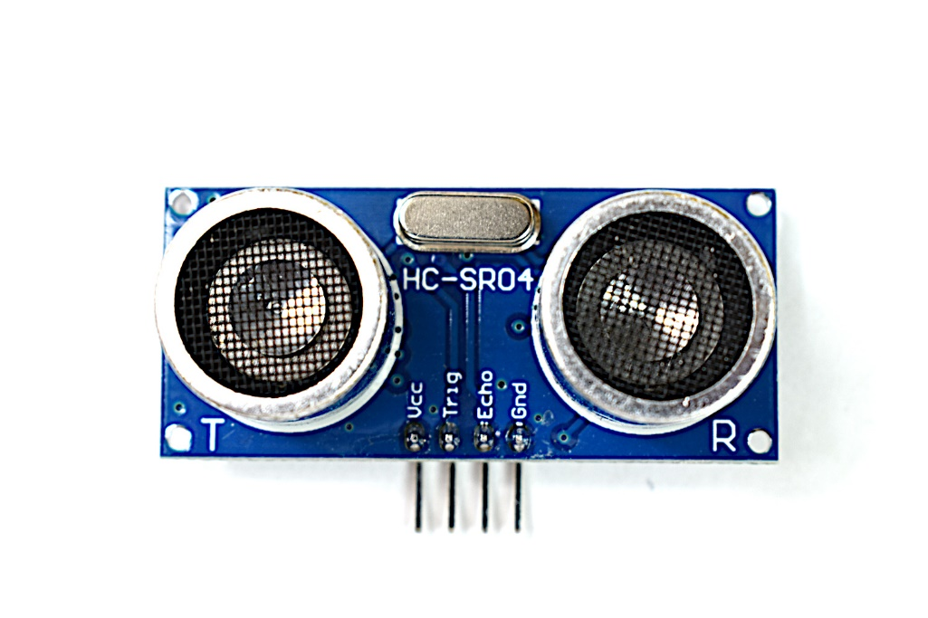
Ultrasonic Sensor - HC-SR04
This is the HC-SR04 ultrasonic sensor module. This economical sensor provides 2cm to 400cm of non-contact measurement functionality with a ranging accuracy that can reach up to 3mm.
Each HC-SR04 module includes an ultrasonic transmitter, a receiver and a control circuit.
UIE-Department of Mechatronics Engineering

Slide 16

BMP-180 Sensor Module
It’s a basic sensor that is designed specifically for measuring atmospheric pressure, which is really useful for two things.
As we travel from sea level to a mountain peak, the air pressure gets lower. That means by measuring the pressure we can determine the altitude. Hence we can use this sensor as an Altimeter.
Because the atmospheric pressure changes with the weather, we can use it to monitor changes in the weather.
UIE-Department of Mechatronics Engineering

Slide 17

LM-393 light sensor
The LM-393 is LDR based Sensor Module that detect the presence of light / measuring the intensity of light.
The output of the module goes high in the presence of light and it becomes low in the absence of light.
The sensitivity of the signal detection can be adjusted using potentiometer.
UIE-Department of Mechatronics Engineering

Slide 18
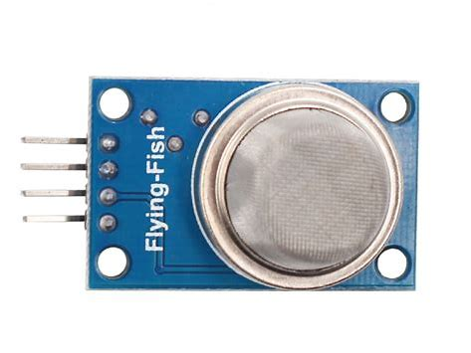
MQ-135 Sensor Module
The MQ-135 Gas sensors is basically used in air quality control equipment's and are suitable for detecting or measuring of NH3, NOx, Alcohol, Benzene, Smoke, CO2 .The gases in PPM the analog pin need to be used. The analog pin is TTL driven and works on 5V and so can be used with most common microcontrollers.
UIE-Department of Mechatronics Engineering

Slide 19
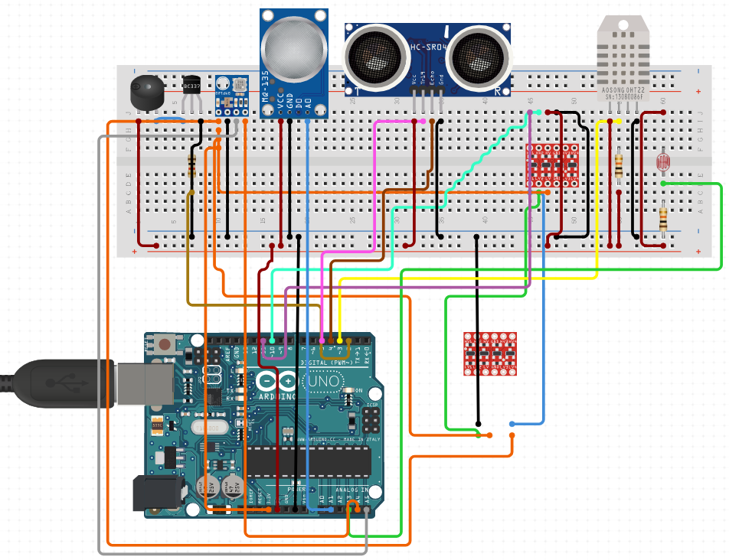
CIRCUIT DIAGRAM
UIE-Department of Mechatronics Engineering

Slide 20
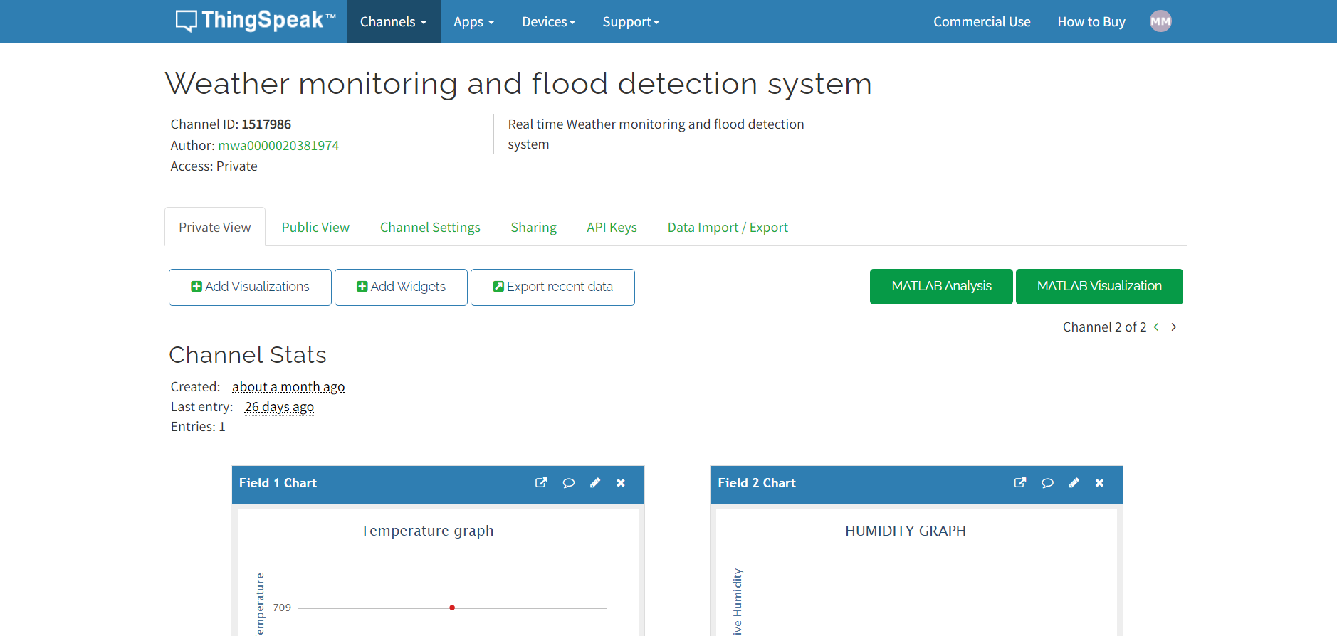
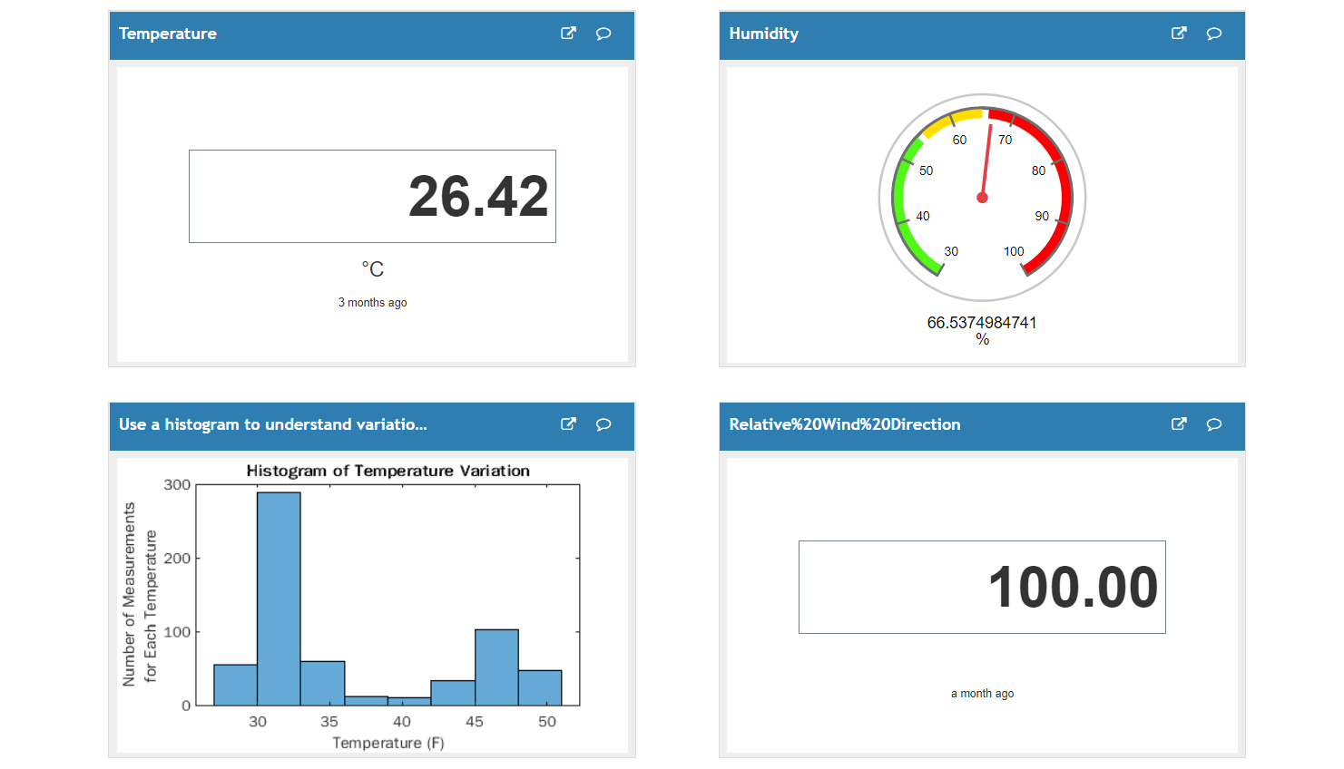
SREEEN SHOT OF THINKSPEAK WEB PAGE
UIE-Department of Mechatronics Engineering

Slide 21
WORK PLAN
WORK PLAN | TIME SPAN
Selection of project based | 15-08-2021 to 01-09-2021
Selection of components and purchasing | 02-09-2021 to 08-09-2021
Deploying of code on system and testing working of prototype | 09-09-2021 to 25-09-2021
Debugging and Troubleshooting and report writing | 25-09-2021 to 15-10-2021
Final assembling and Report writing | 16-10-2021 to 10-06-2021
UIE-Department of Mechatronics Engineering

Slide 22
Work Division
S.NO | NAME OF TEAM MEMEBER | WORK ALLOCATED TO EACH TEAM MEMBER
1. | BIMALENDU BHASKAR PUI | Presentation and coding of HC-SR04 and MQ-135 sensor module
2. | GOURI SANKAR NAYAK | Literature review, and report writing and all paper related work
3. | VISHAL | Prototyping and final assembling of components.
4. | SHIVA THAKUR | Purchasing and specification of project hardware and detailing of sensors
UIE-Department of Mechatronics Engineering

Slide 23
APPROXIMATION COST
S.NO | COMPONENTS USED | PRICE
1 | ARDUINO UNO + Cable | 500
2 | ESP-8266 Wi-fi module | 230
3 | DHT-11 (Temperature & Humidity sensor) | 180
4 | BMP 180 (Pressure and altitude sensor) | 250
5 | MQ 135 (Air Quality monitoring sensor) | 280
6 | HC-SR04 (Ultrasonic sensor) | 180
7 | Rain sensor | 240
8 | LM-393 Module (light sensor Module) | 150
9 | Bread Board, jumper wires, buzzer, led etc. TOTAL COST | 500 2500
UIE-Department of Mechatronics Engineering

Slide 24
WORK DONE BY BIMALENDU PUI
Coding of MQ-135 gas sensor module and HC-SR04 Ultrasonic sensor module.
Making of circuit diagram using circuitio online software
Assisting Gauri sankar in making of Power point presentation, Review papers .
UIE-Department of Mechatronics Engineering

Slide 25
WORK DONE BY GOURI SANKAR
Reviewing various research papers and literature review papers available in this field.
Find various solution for the problems occurred till now by review papers and internet.
Preparing review paper and presentation.
UIE-Department of Mechatronics Engineering

Slide 26
WORK DONE BY SHIVA
Selection of suitable sensors/components for project
Purchasing of all the sensors and other hardware components required after analyzing and review the projects that has similar to your.
Gathering a deep knowledge of how each sensor operates with its specification
Making of power point presentation
Assisting Vishal in debugging
UIE-Department of Mechatronics Engineering

Slide 27
WORK DONE BY VISHAL
Testing of each sensor via code and gathering data from them
Creating Channel on Thinkspeak webpage to upload the data gathered by different sensors for analysis
Trouble shooting and debugging
Preparing Power point presesntation
Final assembling.
UIE-Department of Mechatronics Engineering

Slide 28
Work Achieved
Purchasing of all necessary components like sensors, power sources, wires etc is achieved.
After reading multiple research/review papers we have analyse the actual research gap and literature Review is also done
We have performed testing of each sensor individually and we were successful in obtaining environmental data from them
Designing of circuitry is achieved on fritizing software.
Final Assembling is also done.
UIE-Department of Mechatronics Engineering

Slide 29
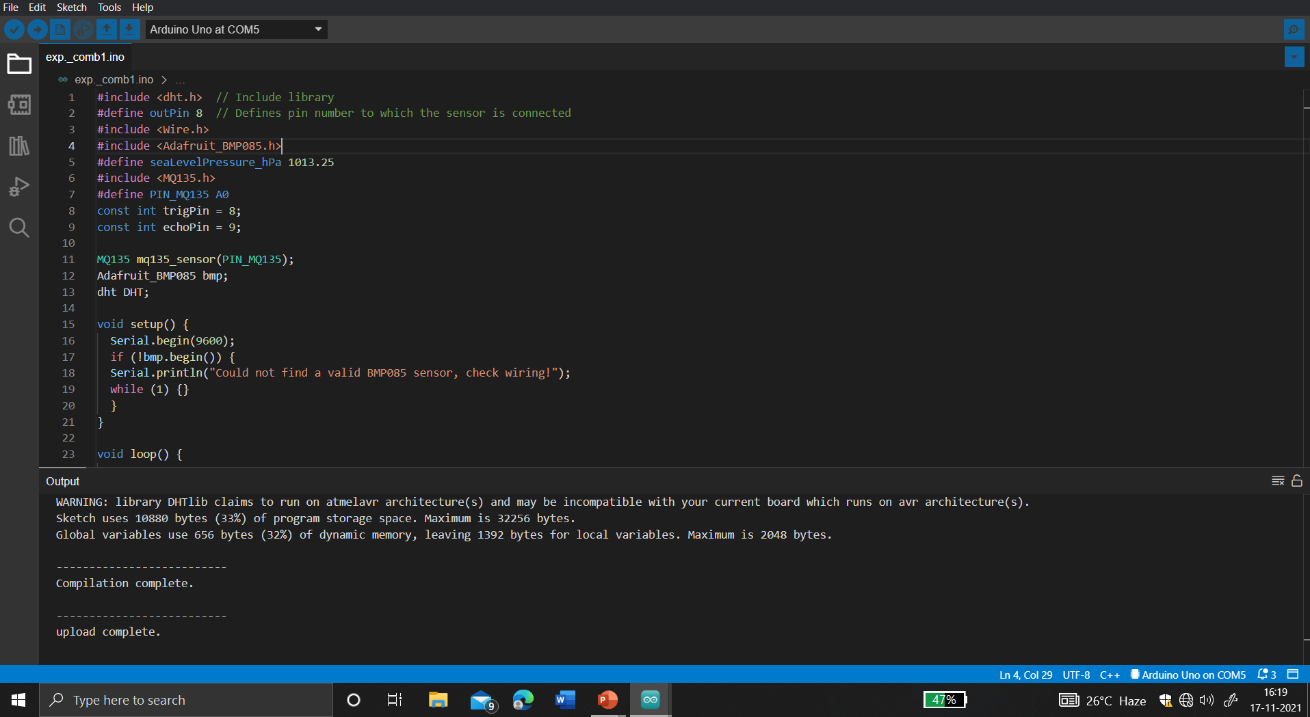
SNAP SHOTS OF WORKING CODE (C++)
UIE-Department of Mechatronics Engineering

Slide 30
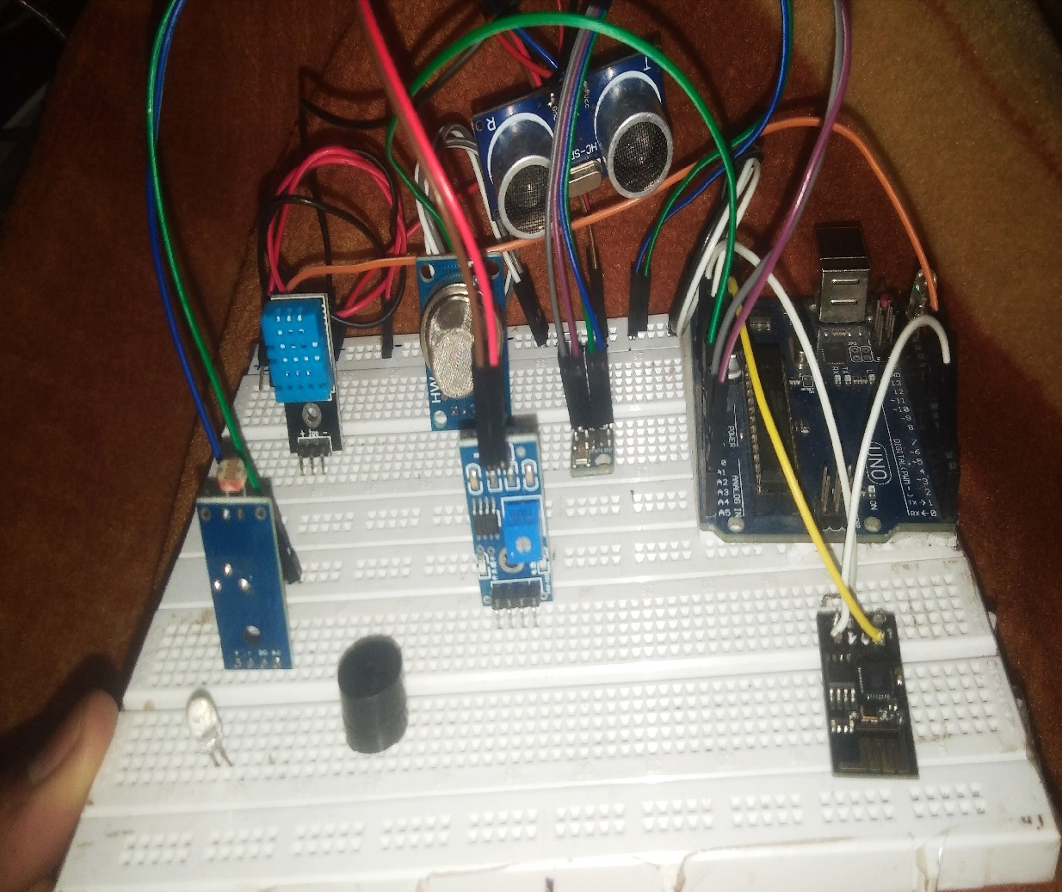
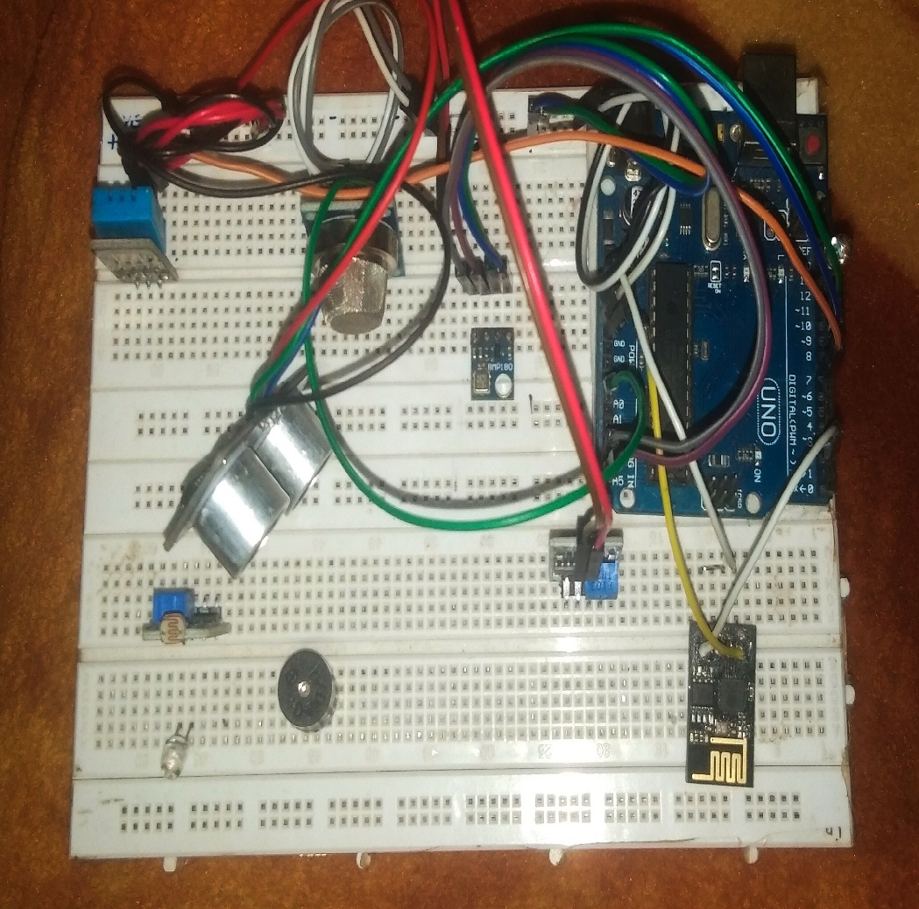
Snap shots of final output
UIE-Department of Mechatronics Engineering

Slide 31
References
[1] D-Robotics (2010). DHT11 Humidity & Temperature Sensor, D-Robotics UK.Retrieved on 18 February 2018 from www.droboticsonline.com.
[2] SMART- SMART-iSTEAMS Multidisciplinary ConferenceOgwuashi-uku, Delta State, NigeriaFebruary 20. Arduino (2018). Arduino Uno Rev3. Available at:http://arduino.cc/en/Main /ArduinoBoardUno>2.
[3] Danladi A., Stephen M., Aliyu B. M., Gaya G. K., Silikwa N. W., Machael Y.(2017). Assessing the influence of weather parameters on rainfall to forecast riverdischarge based on short-term, Alexandria Eng. J. (2017)
[4] Vergel, J. (2012) Real-time hourly forecasting with Armax models with application for real-time flood operation at Angat reservoir.
UIE-Department of Mechatronics Engineering
UIE-Department of Mechatronics Engineering

